Slide 1
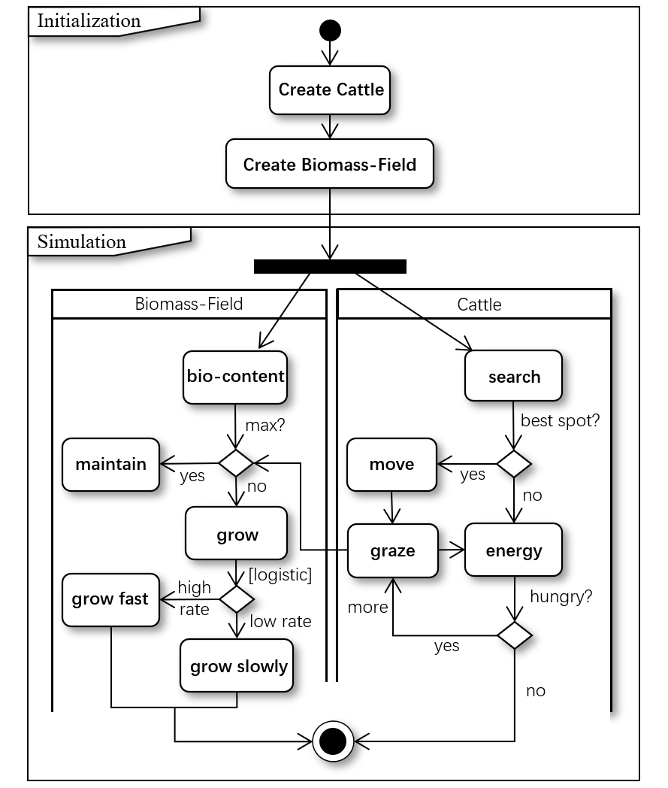
Initialization
Create Cattle
Create Biomass-Field
Simulation
Biomass-Field
Cattle
reduce
identify
identify biomass
move
max?
maintain
graze
yes
no
logistic growth
gain energy

Slide 2
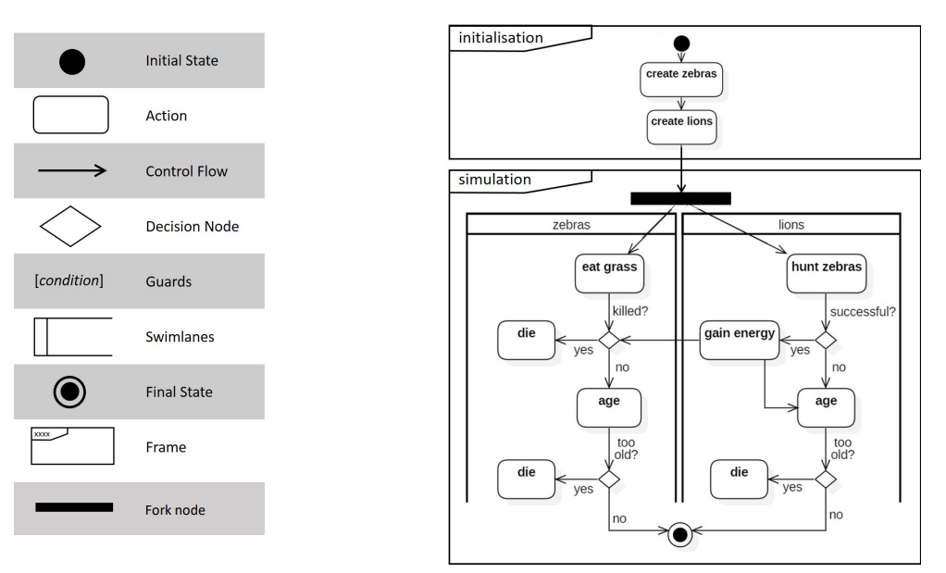
Graze-land interaction?
Cows memory?
Grass feeding energy?
Logistic Model?
Salzburg increasement.
Ancient place growth?
Spatial constraints:mountains, shoppings
Beauties, along the streets
1830
Agent-move-可视域，只能前往可以看到的区域栅格。统计表：显示discovered的区域

Slide 3
Initialization
create boundary
create city centers
create road
create water regions
create slope
define weights of factors
create land use plots
define threshold & max building counts
Simulation
Road
Slope
City centers
Neighbors
Land Use Plots
identify type
get
find nearest
open window
overlap water region
overlap?
calc distance
normalization
calc distance
calc number of urban plots
no
yes
maintain
flag == -1
normalization
normalization
normalization
search all
flag==0?
multiply by weight_road
multiply by weight_s
multiply by weight_cc
multiply by weight_neibor
yes
no
plots set
maintain
constructability
sort
*Comments:
Land use plots, stand for all urban areas and potential plots for urbanization.
Weights of factors, stand for weight of each factor contribute to building constructability.
Threshold, a fixed value, stands for the least value that allows the plot to be urbanized in each time step.
Max building count, stands for the max number of buildings to be constructed in each time step.
select largest in counts
within max counts?
no
flag==0
yes
check threshold
>threshold?
no
flag==0
yes
flag==1

Slide 4
Initialization
create boundary
create city centers
create road
create water regions
create slope
define weights of factors
create land use plots
define threshold & max building counts
Simulation
Land Use Plots
overlap water region
calculate building probability
overlap?
no
yes
maintain
not build
road effect
slope effect
road effect
neighbor effect
search all
flag==0?
identify type
get
find nearest
open window
no
yes
maintain
no building
calc distance
normalization
calc distance
calc number of urban plots
building probability
sort
combine
normalization
normalization
normalization
select largest in counts
multiply by weight_road
multiply by weight_s
multiply by weight_cc
multiply by weight_neibor
within max counts?
no
not build
yes
*Comments:
Land use plots, stand for all urban areas and potential plots for urbanization.
Weights of factors, stand for weight of each factor contribute to building constructability.
Threshold, a fixed value, stands for the least value that allows the plot to be urbanized in each time step.
Max building count, stands for the max number of buildings to be constructed in each time step.
check threshold
>threshold?
no
not build
yes
do build

